Slide 1
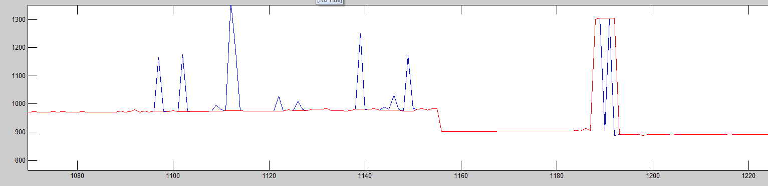
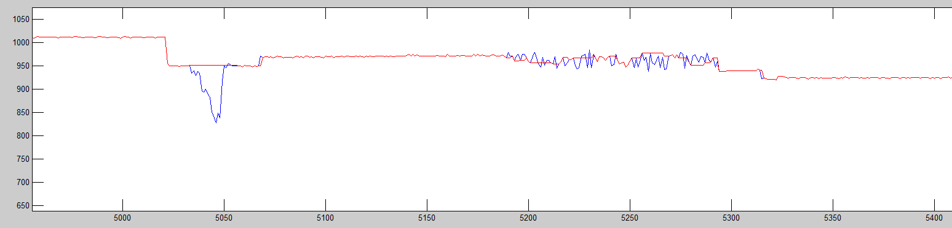
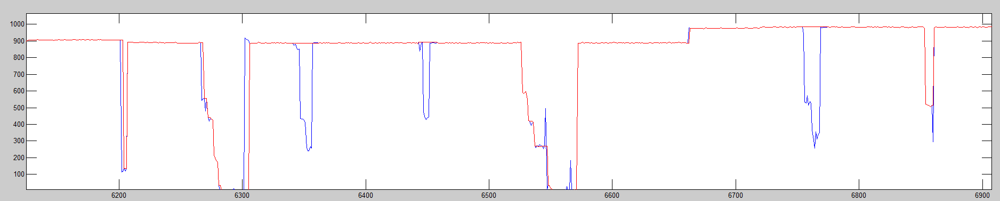
Outlier Remover
5/3/2012
Blue: original
Red: processed
Simple oscillations are removed.
More complex forms of outliers are also removed.
Removes various outliers while maintaining misaligned blocks.

Slide 2
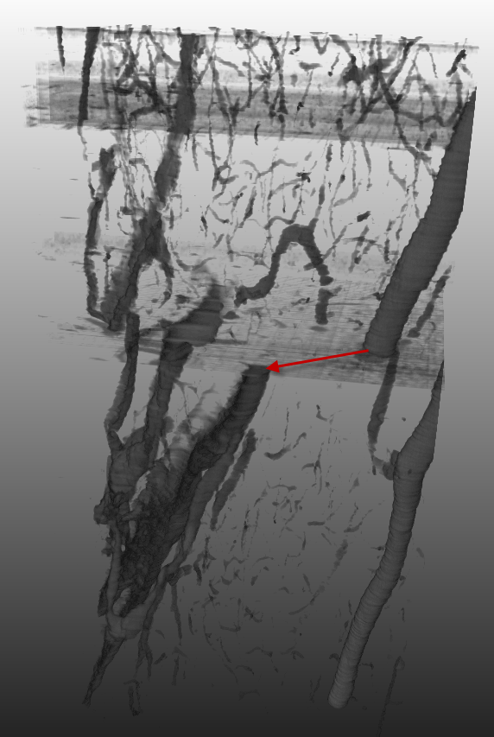
Example of misaligned column
The red arrow show discontinuity. There might be knife cleaning or the KESM restart at the point.
If we crop images with a fixed tissue area, we may get multiple misaligned blocks in a column.
** improvement **
Automatic cropping solved this problem. Yet, due to imperfection of scanning images, the cropping was not successful in some cases.
Also the detected tissue area by the automation has a few pixel margin of errors. Automatically detected areas should be arranged and adjusted. This is a new improvement compared to the previous implementation.
Cropping task will be done by next week. And I will compare this volume with one from the new automatic-cropping.
Note: Noise removal and intensity normalization are not done with the image block.

